Slide 1
GITHUB
Talend Tech Solutions
1

Slide 2
What is GIT ?
Git is an open-source distributed version control system. It is designed to handle minor to major projects with high speed and efficiency. It is developed to coordinate the work among the developers. The version control allows us to track and work together with our team members at the same workspace.
Features of Git
1.Version Control
2.Collaboration
3.Branching and Merging
4.History Tracking
5.Remote Repositories
6.Open Source Contributions
7.Backup and Recovery
8.Flexible Workflow
Talend Tech Solutions

Slide 3
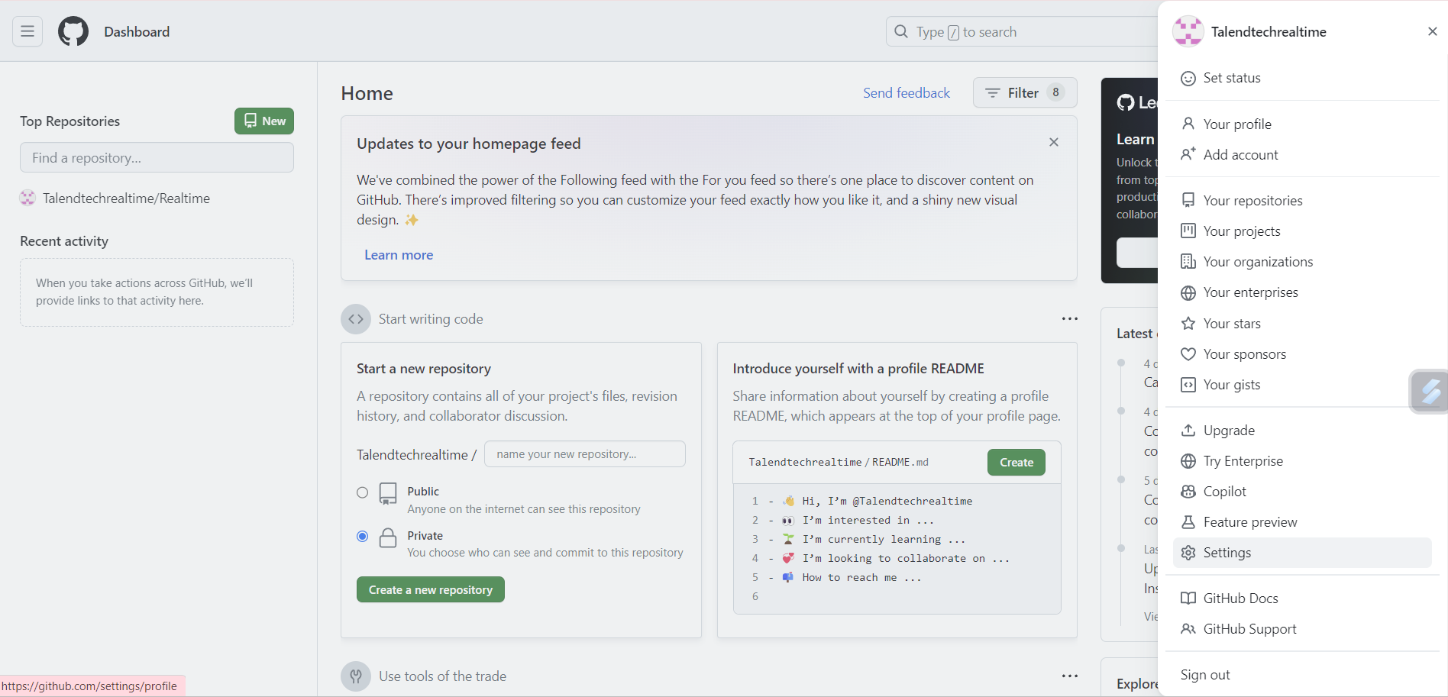
STEP 1:After GIT registration for GIT token

Slide 4
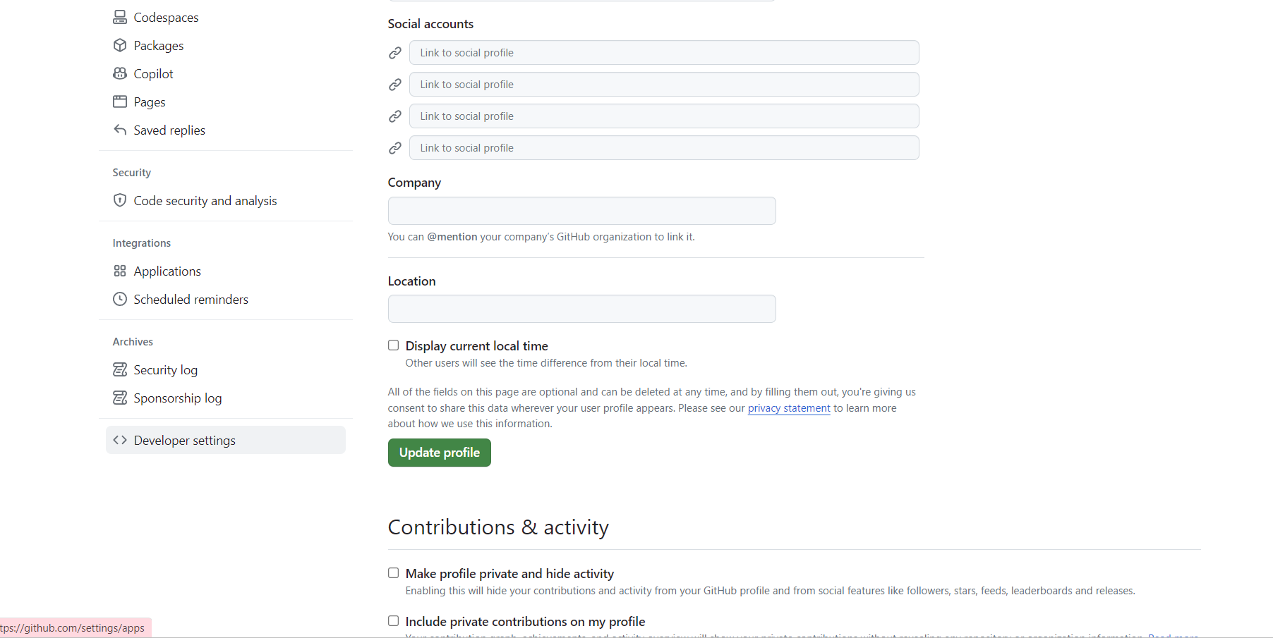
STEP 2: Click on Developer settings

Slide 5
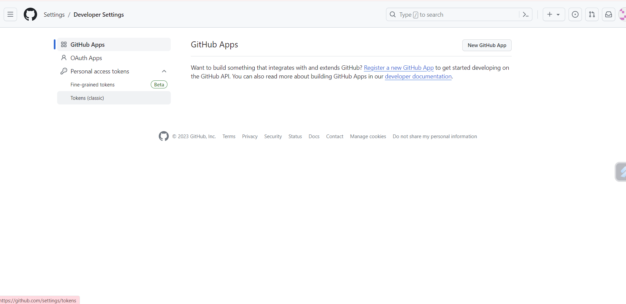
STEP 3: Click on Tokens(classic)

Slide 6
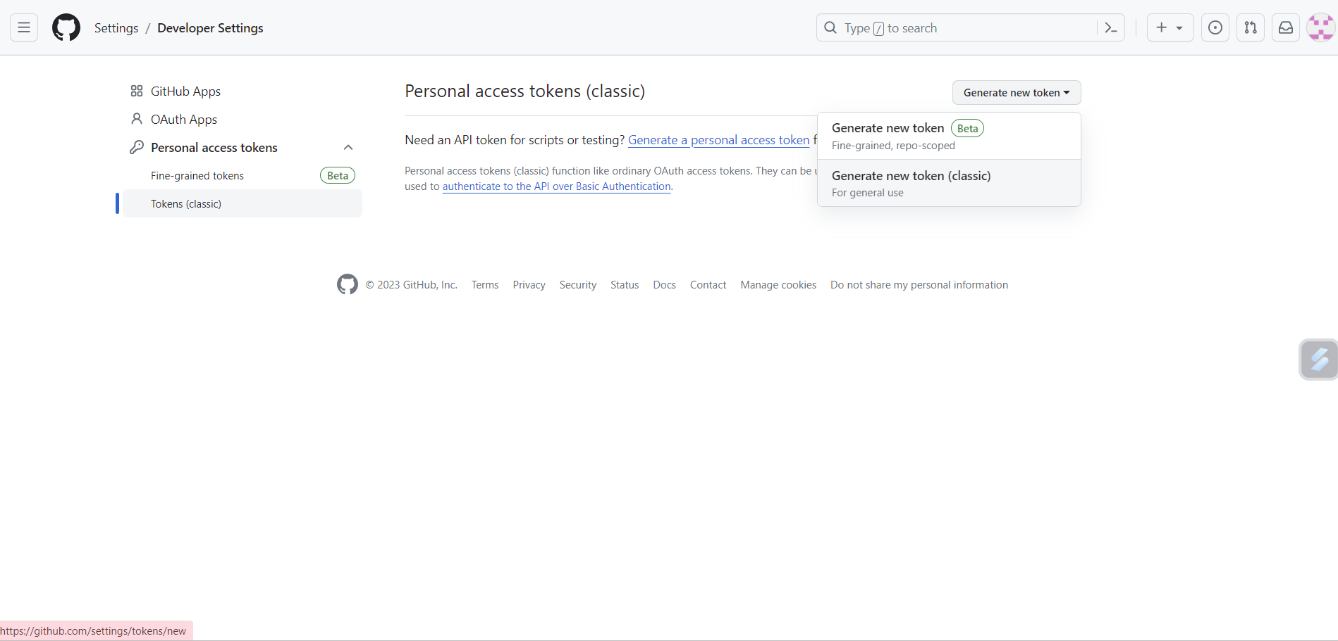
STEP 4: Click on Generate new token (classic)

Slide 7
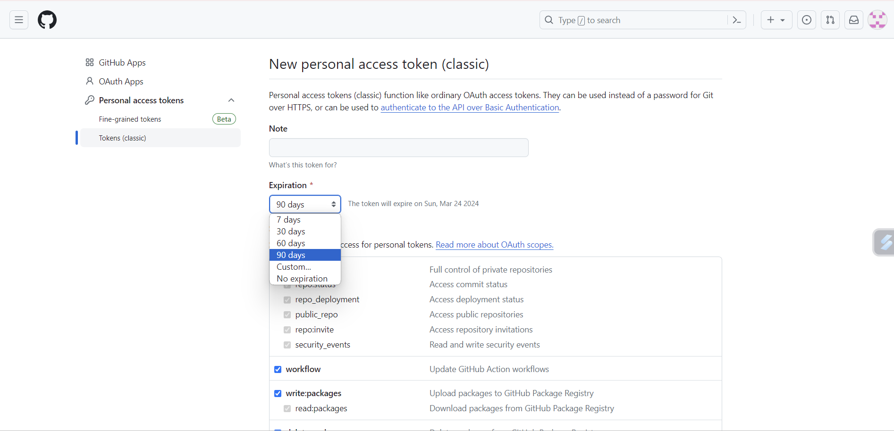
STEP 5: Select expiration and give any name for token in note

Slide 8
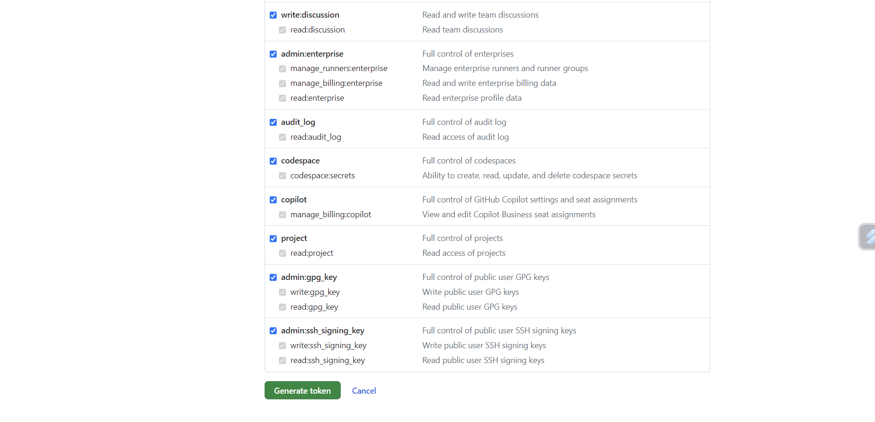
STEP 6: Click on Generate token

Slide 9
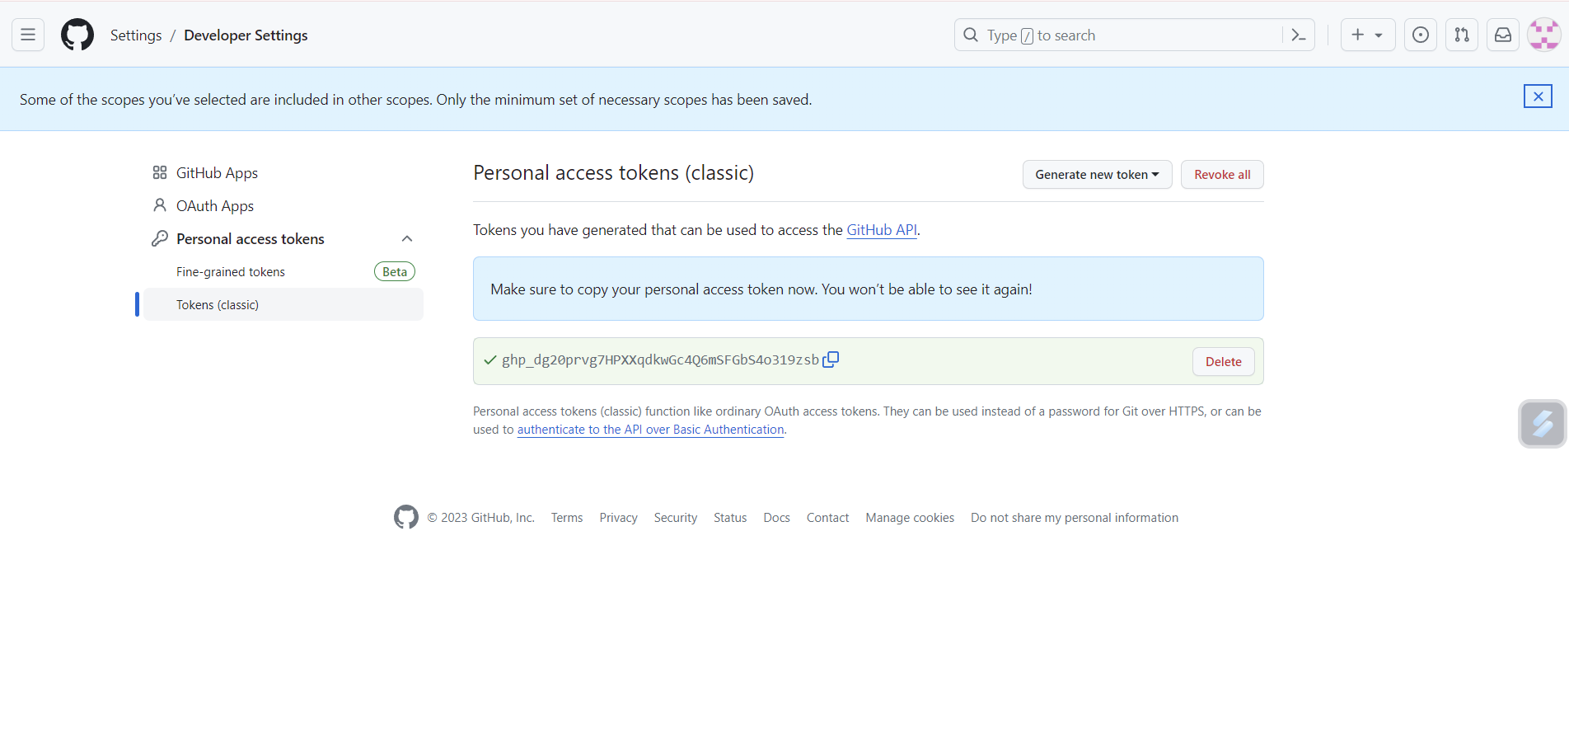
STEP 7: Copy token and save it in notepad.

Slide 10
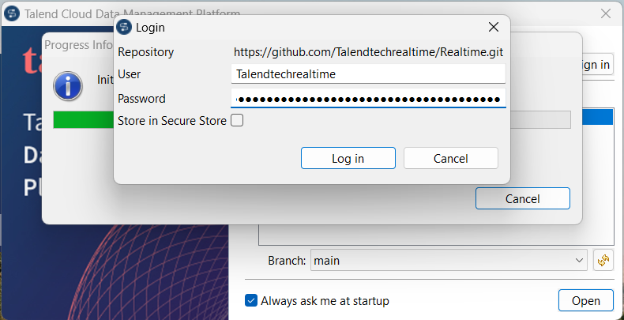
STEP 8: Give the GIT username and token in password when opening Talend enterprise version

Slide 11
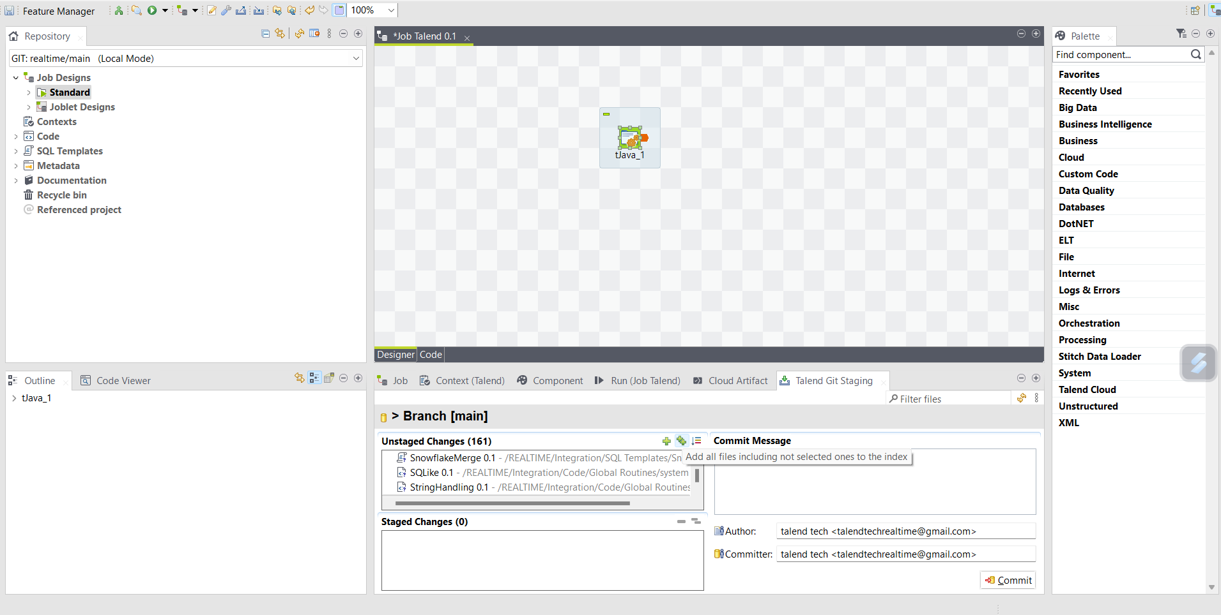
STEP 9: After development of job .In configuration tab click on Talend Git staging then click on unstaged changes ++ symbol

Slide 12
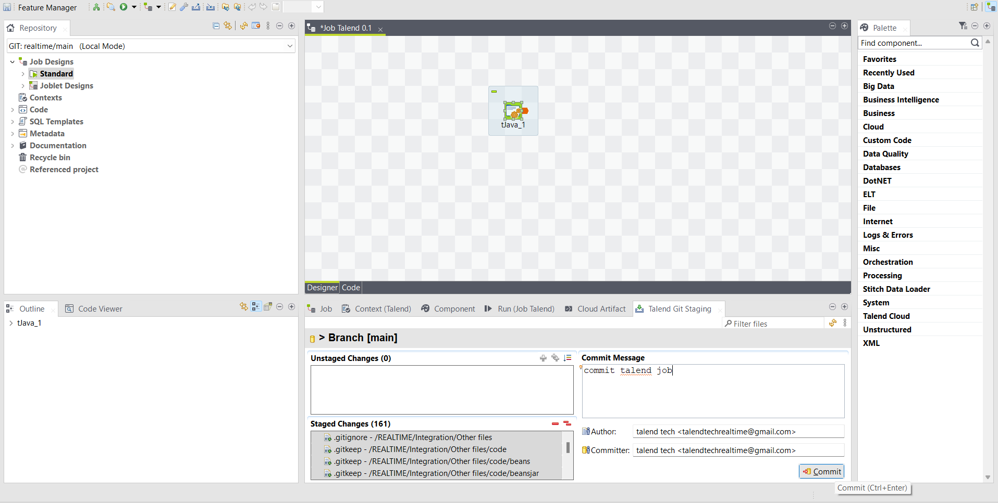
STEP 10: Give the commit message and click on commit

Slide 13
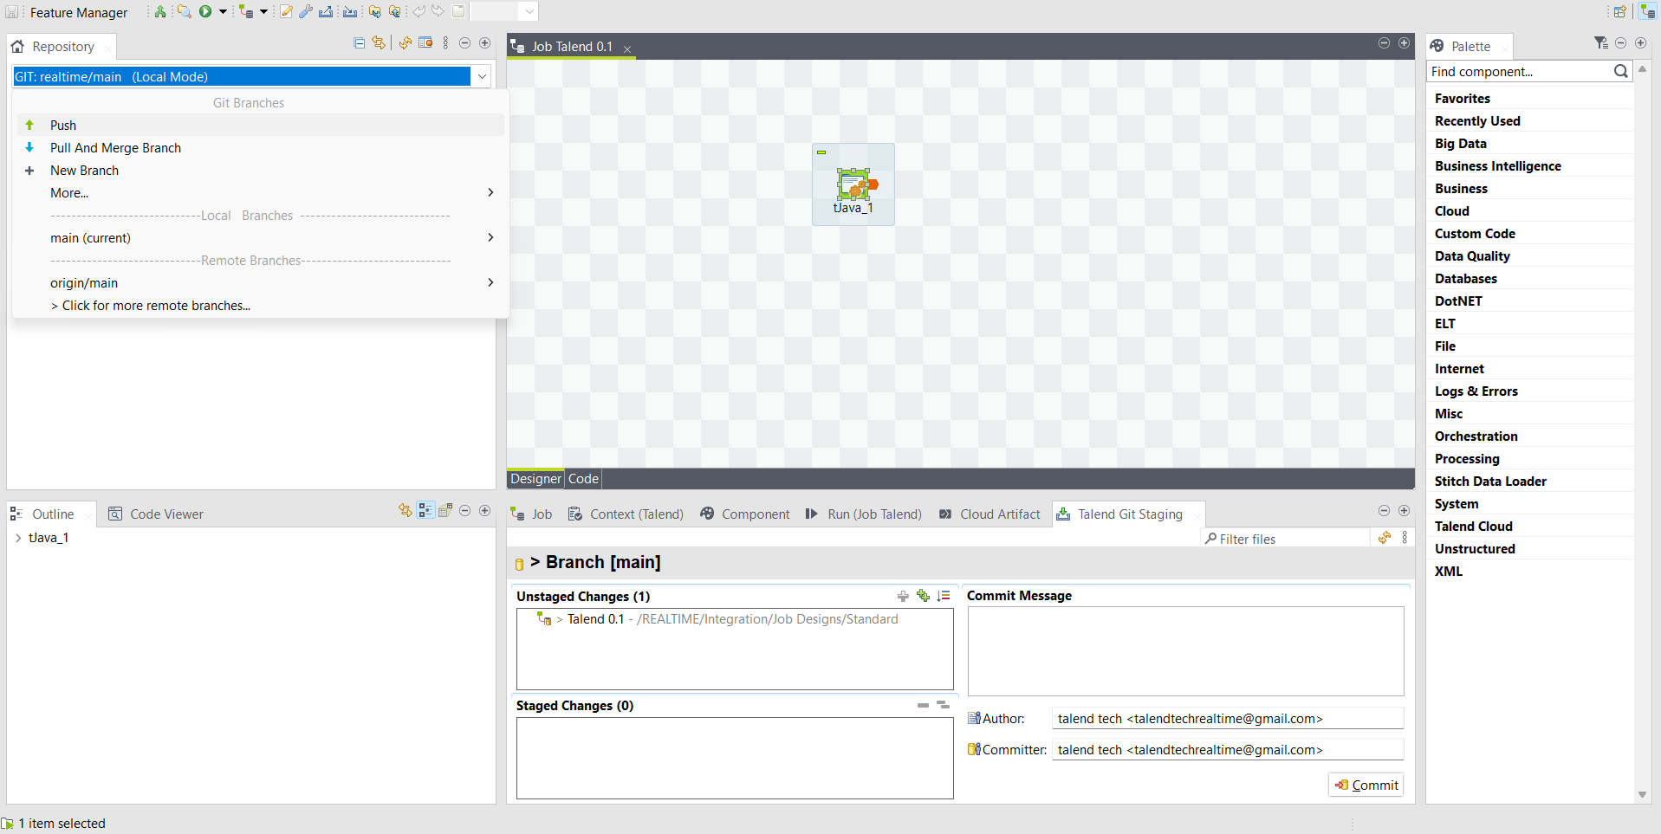
STEP 11: After commit in repository select the branch and push

Slide 14
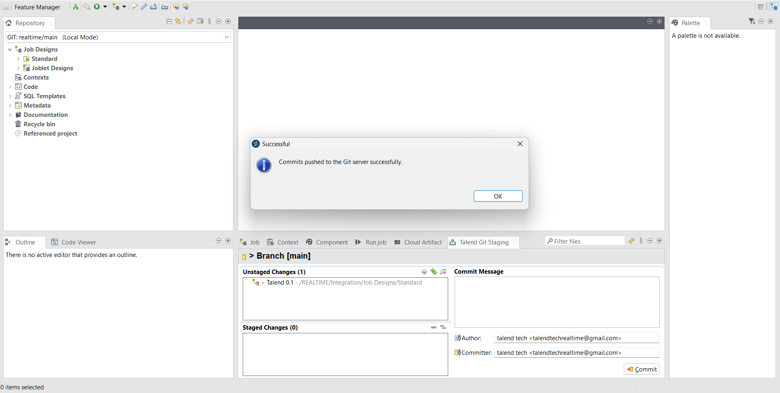
STEP 12: Click on OK

Slide 15
Thank you

